Slide 1

DATA ANALYTICS REPORT
Laptop Market
Data Analysis
Comprehensive Insights from 3,976 Laptop Specifications
Data-Driven Market Intelligence
3,976
18
₹72K
Name : M Vishnu Sai Tej
Internship Role : Data Analyst Intern
UNID : UMID22112571355
Laptop Records
Key Attributes
Avg Price

Slide 2
PRESENTATION ROADMAP
Executive Overview
01
Dataset Overview
02
Market Landscape
Comprehensive data structure, quality metrics, and methodology framework
Brand distribution, market share analysis, and competitive positioning
03
Technical Analysis
04
Price Correlations
Processor, RAM, GPU, storage, and battery performance insights
Specification-price relationships and key value drivers
05
Segment Analysis
06
Strategic Insights
Gaming, budget, and professional laptop category deep-dives
Data-driven recommendations and market opportunities

Slide 3
01
FOUNDATION
Dataset Overview: Foundation of Analysis
Dataset Structure & Coverage
Data Quality Metrics
Completeness
99.2%
3,976
18
6
100%
Total Records
Key Attributes
Major Brands
Data Quality
Accuracy
98.7%
Core Attributes
Price Range (₹)
Consistency
97.5%
Brand
Price
Processor
RAM
GPU
Storage
Minimum
7,990
Display
Battery
Maximum
503,890
Average
72,433
Analytical Tools
Python (Pandas, NumPy)
Data Preprocessing Methodology
Matplotlib, Seaborn
Scikit-learn ML
Jupyter Notebooks
Missing Value
Outlier
Categorical
Feature
Imputation
Detection
Encoding
Scaling

Slide 4
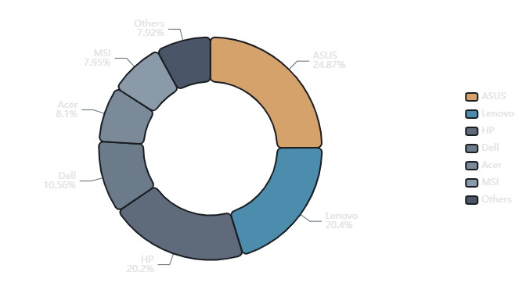
02
MARKET DYNAMICS
Market Landscape: Brand Distribution & Market Share
Brand Market Share Distribution
Top 6 Brands Performance
ASUS
24.9%
989 models
Market Leader
Lenovo
20.4%
811 models
Strong #2
HP
20.2%
803 models
Close #3
Dell
10.6%
420 models
Acer
8.1%
322 models
MSI
7.9%
316 models
Market Concentration
Top 3 Share
65.5%
HHI Index
1,847
Competition
Moderate
Key Insight: ASUS dominates with diverse portfolio spanning gaming (ROG), premium (ZenBook), and budget (VivoBook) segments. Lenovo and HP maintain strong positions through enterprise and consumer channels respectively.

Slide 5
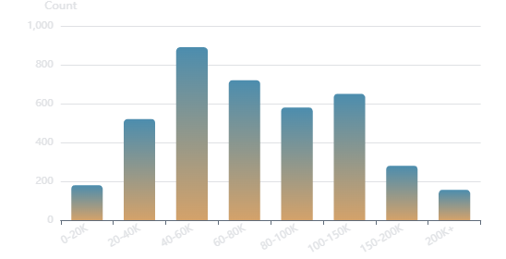
02
PRICING INSIGHTS
Price Distribution Analysis: Market Segmentation
Price Distribution Histogram
Price Segments
Budget Segment
< ₹40K
Entry-level laptops for basic computing
25% of market
Avg: ₹28,500
Mid-Range Segment
₹40K - 80K
Balanced performance for professionals
40% of market
Avg: ₹58,200
Premium Segment
₹80K - 150K
High-performance gaming & creative
Statistical Summary (₹)
25% of market
Avg: ₹108,400
72,433
58,990
Ultra-Premium
> ₹150K
Mean
Median
Flagship gaming & workstation
52,208
495,900
10% of market
Avg: ₹245,600
Std Dev
Range
Pricing Insight: Right-skewed distribution indicates majority of laptops cluster in budget-midrange segments. High variance (₹52,208) reflects diverse positioning strategies across brands and categories.

Slide 6
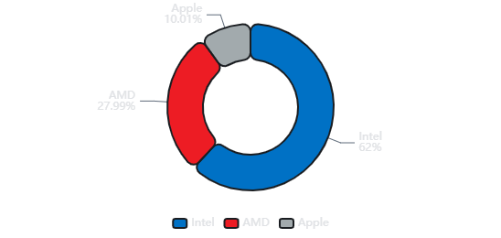
03
PROCESSOR ANALYSIS
Processor Ecosystem: Intel vs AMD vs Apple
Processor Brand Distribution
Brand Positioning Analysis
Intel
Market Leader
Dominates with broad portfolio from Celeron (budget) to Core i9 (premium). Strong enterprise presence. 12th/13th gen showing significant performance gains.
62% Share
Broad Range
AMD
Value Champion
Strong value proposition with Ryzen 5/7 series. Competitive multi-core performance. Growing presence in gaming laptops with Ryzen 9 flagship.
28% Share
Best Value
Clock Speed Distribution (GHz)
Intel
Avg: 2.8 GHz
Apple Silicon
AMD
Avg: 3.2 GHz
Premium Innovation
M-series chips deliver exceptional performance-per-watt. Premium pricing with MacBook Air/Pro. Industry-leading battery efficiency and thermal management.
Apple M-Series
Avg: 3.2 GHz
10% Share
Premium

Slide 7
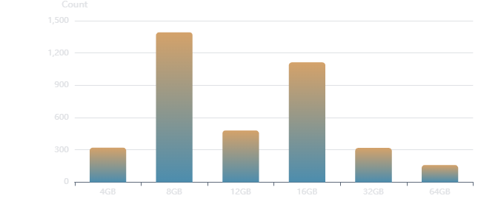
03
MEMORY ANALYSIS
Memory Configuration: RAM Trends & Patterns
RAM Capacity Distribution
RAM Configuration Insights
8GB RAM
35%
Most common configuration
Budget & mainstream laptops
16GB RAM
28%
Growing popularity
Gaming & professional
32GB+ RAM
8%
High-end segment
RAM Type Distribution
Workstation & flagship
58%
22%
12%
8%
DDR4
DDR5
LPDDR4X
LPDDR5
Key Statistics
Average RAM
11.15 GB
Median RAM
8 GB
RAM Expandable
42%
RAM Insight: Strong positive correlation (r=0.68) between RAM capacity and price. DDR5 adoption accelerating in premium segment. 16GB becoming new standard for gaming and professional use.

Slide 8
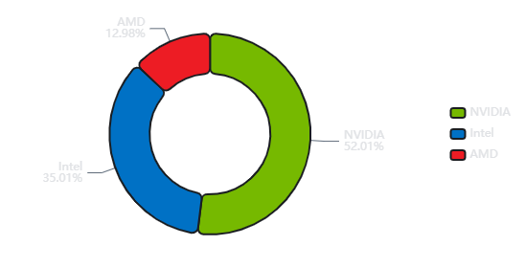
03
GPU ANALYSIS
Graphics Landscape: GPU Brand Distribution
GPU Brand Market Share
GPU Performance Tiers
NVIDIA
52%
Gaming & Professional Leader
RTX 4090
RTX 4080
RTX 4070
RTX 4060
RTX 3060
RTX 3050
Intel
35%
Integrated Graphics Dominance
Iris Xe
UHD
Arc A-Series
AMD Radeon
13%
GPU Type Distribution
Value Gaming Alternative
RX 7600M
RX 6700M
RX 6600M
58%
42%
Integrated Graphics
Dedicated GPU
Intel/AMD iGPU
NVIDIA/AMD dGPU
GPU Insight: NVIDIA commands premium pricing with RTX series. Dedicated GPU laptops average ₹95,000 vs ₹48,000 for integrated. RTX 3060/4060 most popular for mid-range gaming.

Slide 9
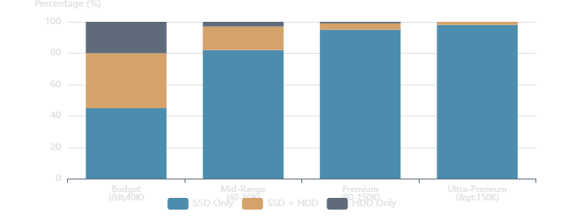
03
STORAGE ANALYSIS
Storage Evolution: SSD vs HDD Adoption
Storage Configuration Trends
SSD Capacity Distribution
256GB
22%
512GB
38%
1TB
28%
2TB+
12%
Storage Insights
SSD adoption at 93% shows near-complete transition from HDD
512GB emerges as sweet spot for mainstream users
Storage Type Adoption
1TB+ configurations concentrated in premium segment
Hybrid configs still relevant in budget gaming
78%
15%
7%
SSD Only
SSD + HDD
HDD Only
Storage Insight: NVMe SSDs command ₹8,000-15,000 premium over SATA. Price correlation (r=0.45) with storage capacity. Gaming laptops increasingly adopting 1TB as standard.

Slide 10
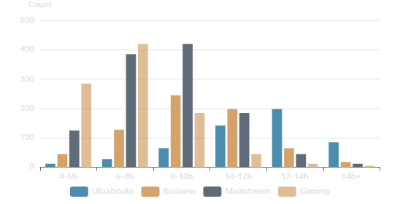
03
BATTERY ANALYSIS
Battery Performance: Endurance Analysis
Battery Life Distribution by Category
Battery Performance by Category
Ultrabooks
12.5h
Premium thin & light laptops
Intel Evo
Apple M
Business Laptops
10.2h
Enterprise-focused devices
ThinkPad
EliteBook
Mainstream
7.8h
Statistical Summary
General-purpose laptops
IdeaPad
Pavilion
8.15h
8.0h
2.8h
18h
Mean
Median
Std Dev
Max
Gaming Laptops
6.2h
High-performance gaming
ROG
Legion
OMEN
Battery Insight: Weak negative correlation (r=-0.22) between battery life and price. Gaming laptops sacrifice battery for performance. Apple M-series leads efficiency with 15+ hour real-world usage.

Slide 11
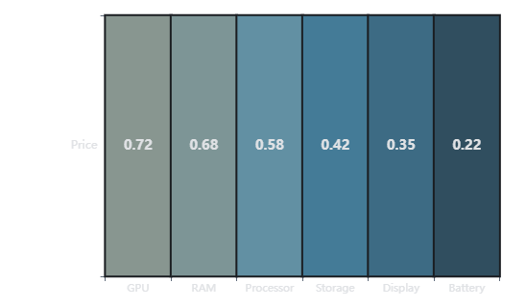
04
CORRELATION ANALYSIS
Price Correlation Insights: Key Drivers
Specification-Price Correlation Matrix
Key Price Drivers
GPU Brand
0.72
Strongest price predictor
NVIDIA commands significant premium over integrated graphics
RAM Capacity
0.68
Strong positive correlation
Each 8GB increment adds ₹12,000-18,000 to price
Processor Gen
0.58
Moderate correlation
Newer generations command 15-25% premium
Correlation Strength Scale
0.7-1.0
0.4-0.7
0.1-0.4
0.0-0.1
Display Size
0.42
Strong
Moderate
Weak
None
Weak-moderate correlation
Larger displays associated with premium categories
Correlation Insight: GPU and RAM are primary price determinants. Brand premium varies significantly—Apple commands 35% premium, MSI 20% for gaming features. Storage type shows minimal correlation (0.15).

Slide 12
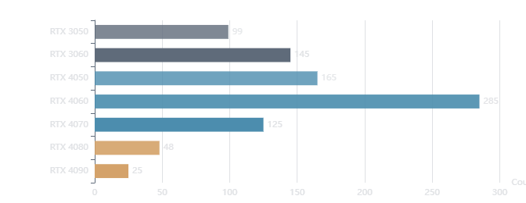
05
SEGMENT ANALYSIS
Gaming Laptop Segment: Performance Premium
Gaming GPU Distribution
Gaming Configuration Profile
GPU
NVIDIA Required
RTX 3050/3060/4060 most common
RAM
16GB Standard
68% have 16GB+, 32GB for flagship
Display
15.6" - 17.3"
144Hz/165Hz high refresh rate
Storage
512GB - 1TB SSD
NVMe SSD for fast game loading
Gaming Segment Overview
892
22.4%
₹85K
6.2h
Gaming Price Tiers
Models
Market Share
Avg Price
Avg Battery
Entry Gaming
₹55K-75K
Mid Gaming
₹75K-110K
High Gaming
₹110K-180K
Flagship
₹180K+
Gaming Insight: Gaming laptops command 17% price premium over mainstream. RTX 4060 emerges as sweet spot at ₹85K-100K. Brand leaders: ASUS ROG (28%), MSI (22%), Lenovo Legion (18%).

Slide 13
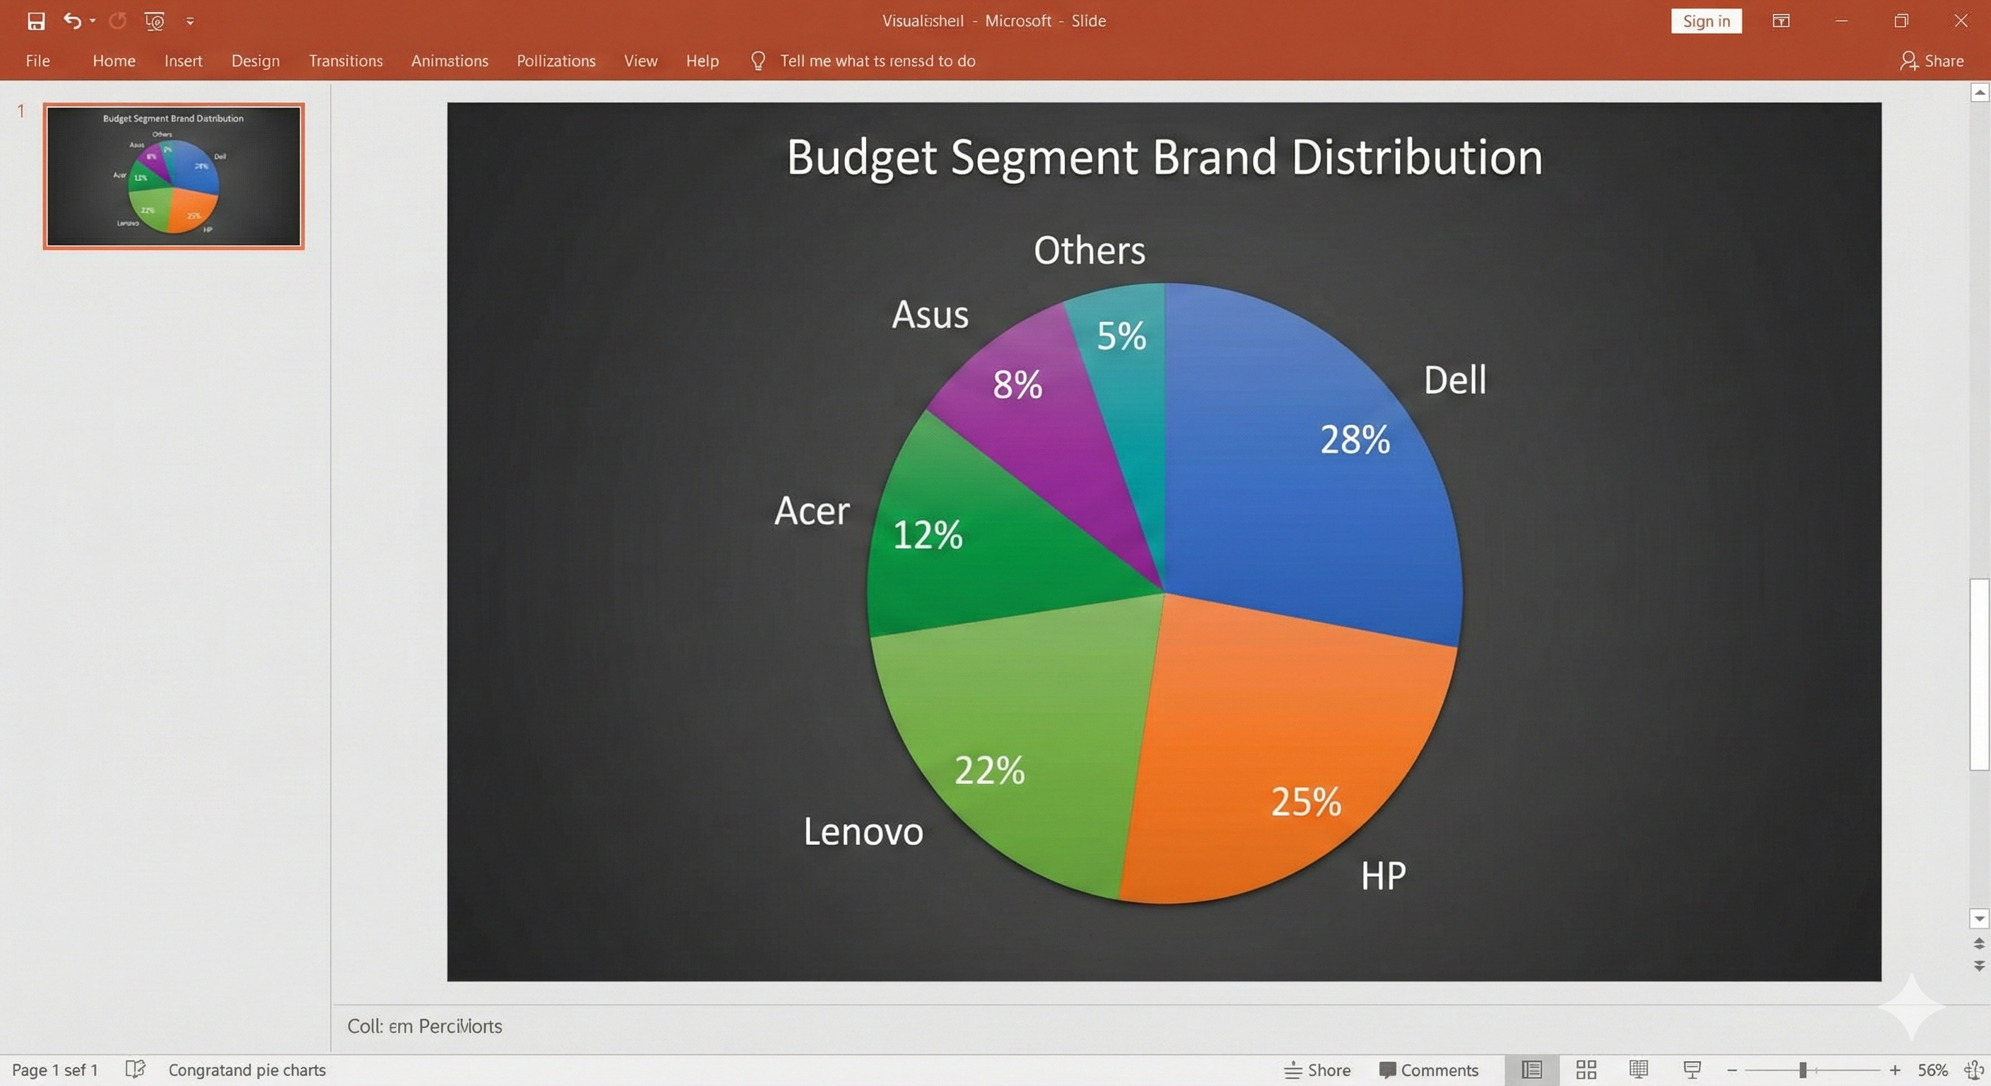
05
SEGMENT ANALYSIS
Budget Segment Analysis: Value Optimization
Budget Segment Brand Distribution
Optimal Budget Configuration
Processor
AMD Ryzen 3/5 or Intel Core i3
Ryzen 5 5500U
i3-1215U
Memory
8GB DDR4 (expandable preferred)
8GB DDR4
Expandable
Storage
256-512GB SSD or 1TB HDD
Budget Segment Overview
512GB SSD
1TB HDD
994
25%
₹28.5K
8.5h
Models
Market Share
Avg Price
Avg Battery
Display
14"-15.6" Full HD (1920x1080)
15.6" FHD
IPS Panel
Budget Insight: Acer, HP, and Lenovo dominate budget segment with 65% combined share. AMD Ryzen offers superior value over Intel at this price point. SSD adoption at 68% shows rapid transition from HDD.

Slide 14
06
STRATEGIC INSIGHTS
Strategic Recommendations: Data-Driven Insights
For Budget Buyers
For Professionals
Under ₹40,000
Business & Creative Work
1
Processor: AMD Ryzen 5 5500U or Intel i3-1215U for optimal price-performance
1
Battery Priority: Target 10+ hours for mobile productivity
2
Memory: 8GB DDR4 with expansion slot for future upgrade
2
Processor: Intel Evo or Apple M-series for efficiency
3
Storage: Prioritize 512GB SSD over 1TB HDD for better performance
3
Build Quality: MIL-STD durability for travel reliability
4
Brands: Acer Aspire, HP 15s, Lenovo IdeaPad offer best value
4
Brands: ThinkPad, EliteBook, MacBook Pro excel here
For Gaming Enthusiasts
Market Opportunities
₹70,000 - ₹150,000
16GB RAM Adoption: Growing demand in mid-range segment presents upgrade opportunity
1
GPU Sweet Spot: RTX 4060 at ₹85K-100K offers best price-performance
2
RAM Standard: 16GB DDR5 for modern AAA gaming requirements
DDR5 Transition: Early adopters gaining performance advantage
Display: 144Hz minimum for competitive gaming advantage
QHD Displays: Premium segment showing 1440p preference
3
AI Features: NPU integration emerging as differentiation factor
4
Brands: ASUS ROG, Lenovo Legion, HP OMEN lead reliability

Slide 15

ANALYSIS COMPLETE
Key Takeaways &
Next Steps
Market Segmentation
Price Drivers
Clear specification-price correlations with distinct gaming, professional, and budget segments
GPU and RAM are primary determinants with strong correlation to pricing
Brand Leadership
Future Trends
ASUS, Lenovo, HP dominate through diversified portfolios across all price tiers
AI integration, ARM adoption, and sustainability shaping next evolution
Future Analysis Directions
AI Integration
ARM Transition
Sustainability
NPU & on-device ML
Snapdragon & Apple
Eco-friendly materials

Slide 16
THANK YOU
Thank you for your time and attention

